Slide 1


Artem Kutepov
09.10.2023

Slide 2

Outline
Executive Summary - 3
Introduction - 5
Methodology - 9
Results - 22
Conclusion - 55

Slide 3
Executive Summary
Perform data wrangling
Modify and add columns, useful for training models
Perform exploratory data analysis (EDA) using visualization and SQL
Perform interactive visual analytics using Folium and Plotly Dash
Perform predictive analysis using classification models:
Break dataset into training and test data
Develop various models (KNN, Decision Tree, etc…) using train data
Assess accuracy scores of models and their best parameters using test data

Slide 4
Executive Summary
SpaceX’s successful recoveries generally have the following properties:
A launch date in the year 2017 or later
Light payload (in the range 2000-4000kg)
Launched from site KSC LC-39A
Successfully recovered via drone ship
Our machine learning model can predict the outcome of a given recovery with a reasonable degree of accuracy, 83.33%

Slide 5
Introduction
Most pace exploration companies may spend up to $165 million per rocket launch
With their flagship Falcon 9 rocket, SpaceX has cut down this cost to only $62 million per launch
How?

Slide 6
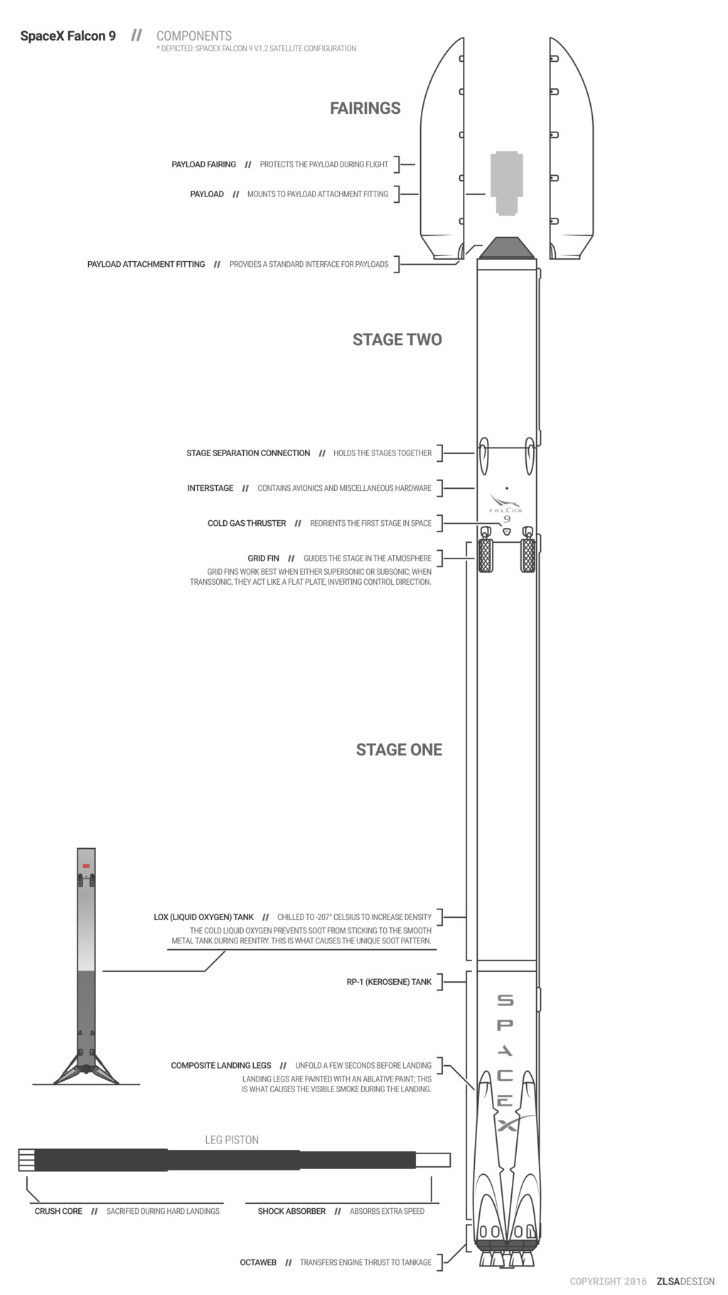
Introduction
It’s not rocket science!
With the Falcon 9, SpaceX is able to recover and reuse Stage One, a large and expensive component of the rocket
Recovery of Stage One means drastically reduced manufacturing costs
(Created by - Forest Katsch, zlsadesign.com)

Slide 7
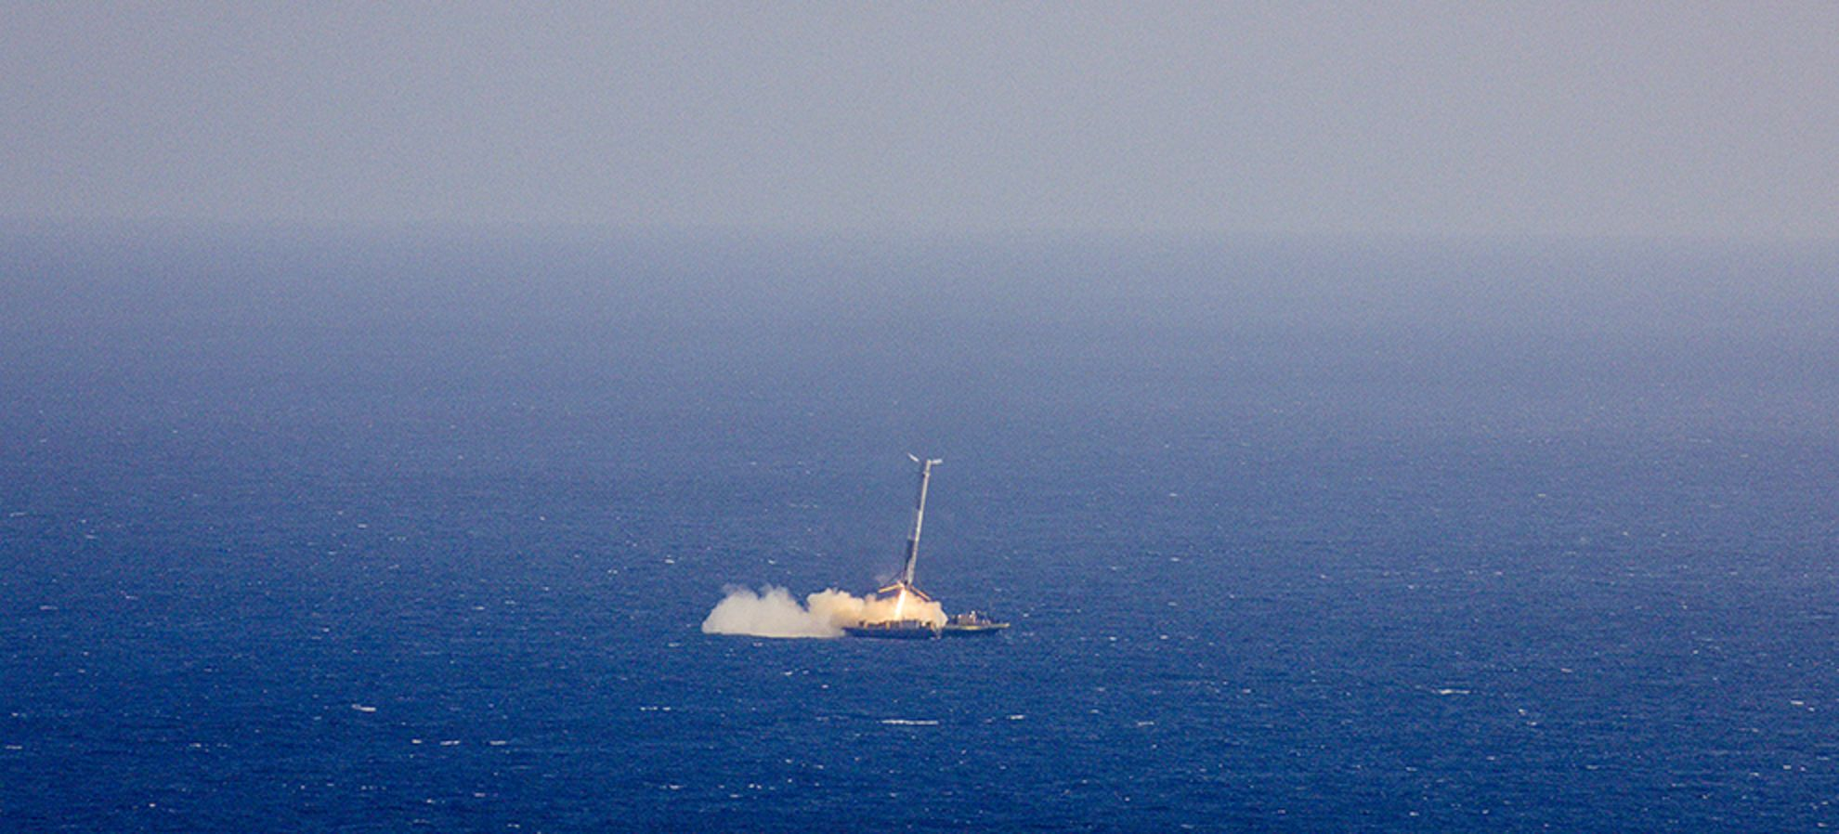
Introduction
Of course, a successful Stage One recovery is not guaranteed..

Slide 8
Introduction
The outcome of a landing will have a significant effect on the overall cost of a launch
So, we will be training machine learning models to predict whether or not a SpaceX Stage One recovery will be successful
With this knowledge, we will be able to copy the aspects of successful recoveries with our own SpaceY rockets and ensure that we will be able to save millions

Slide 9

Section 1

Slide 10
Methodology
Data collection methodology:
Collect rocket launch data from SpaceX API
Perform data wrangling
Modify and add columns, useful for training models
Perform exploratory data analysis (EDA) using visualization and SQL
Perform interactive visual analytics using Folium and Plotly Dash
Perform predictive analysis using classification models
Break dataset into training and test data
Develop various models (KNN, Decision Tree, etc…) using train data
Assess accuracy scores of models and their best parameters using test data

Slide 11
Data Collection
To collect our data, we need to:
Download a .json file containing rocket launch data from the SpaceX API
Parse the information into a dataframe
Convert null values of quantitative variables into the mean of the rest of the column

Slide 12
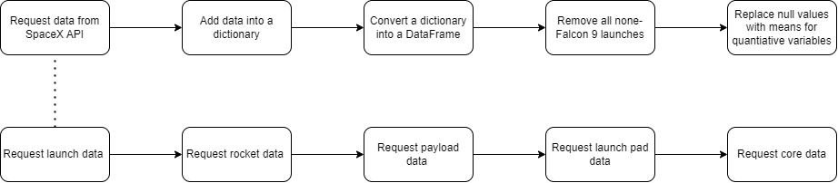
Data Collection – SpaceX API
Link to GitHub repo

Slide 13
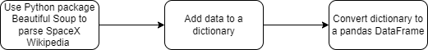
Data Collection - Scraping
Link to GitHub repo

Slide 14
Data Wrangling
A key point of this project is to determine whether a recovery was successful or not
So how do we distinguish between «successful» or «unsuccessful»?
According to our dataframe, there are 8 different outcomes, each of which can be considered a Success or Failure:
True ASDS → Successful landing to drone ship
True RTLS → Successful landing on a ground pad
True Ocean → Successful landing in ocean
None None → Failed to land
None ASDS → Failed to land
False ASDS → Failed to land on drone ship
False RTLS → Failed to land on ground pad
False Ocean → Failed to land in ocean

Slide 15
Data Wrangling
From here, we could create a new column, «class», to delineate between successful and unsuccessful recoveries:
1 → successful recovery
0 → unsuccessful recovery
• From here, we are ready to do some more advanced EDA

Slide 16

Data Wrangling
Link to GitHub repo

Slide 17
EDA with Data Visualization
Here, a number of plots showing relationships between different variables:
Flight Number vs. Payload (Cat plot)
Flight Number vs. Launch Site (Cat plot)
Launch Site vs. Payload (Scatter plot)
Success Rate vs. Orbit type (Bar plot)
Orbit type vs. Flight Number (Scatter plot)
Orbit type vs. Payload (Scatter plot)
Success rate vs. Time in years (Line plot)
An explanation of these various plots are shown in Section 2
We also perform some one-hot encoding in this section
Link to GitHub repo

Slide 18
EDA with SQL
Using SQL allows us to make complicated queries without much difficulty
Here, we make some basic queries on our data to get a better sense for the relationships between variables, particularly the following:
Launch Site
Payload Mass (kg)
Mission Outcome
Booster Version
Date
Link to GitHub repo

Slide 19
Build an Interactive Map with Folium
Using the Python package Folium, we created an interactive map where one can:
View where each Falcon 9 launch site is located, represented by a circle
Learn how many launches occurred at each location, represented by markers. Green markers represent a successful recovery while red markers represent unsuccessful one
Determine distances to the closest coastline, city, railway, and highway, each represented by a blue line.
Link to GitHub repo
Note: Github does not support Folium maps natively

Slide 20
Build a Dashboard with Plotly Dash
Through Plotly Dash, we made a dashboard that shows:
A pie chart showing the proportion of successful recoveries to unsuccessful ones for each site (which can be changed via a dropdown menu)
A Recovery Outcome vs. Payload Mass scatter plot with a range (0-10000kg) with bounds that can be changed by the user
This dashboard provides insight into the launch sites’ and payload masses’ relationships with the recovery outcomes.
Link to GitHub repo

Slide 21
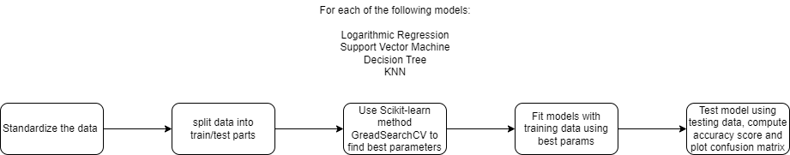
Predictive Analysis (Classification)
Link to GitHub repo

Slide 22
Results
EDA Results:
SpaceX has gotten better at launching rockets overtime. Launches are most successful when launched in 2017 or later
Light payloads are evidently easier to recover, as most successful recoveries occur when the payload has a mass between 2000kg and 4000kg
Each launch site is reasonably successful in their own right, but site KSC LC-39A appears to be ideal as it has a success rate of over 75%
The best recovery method appears to be via drone ships. This would make sense as SpaceX has much more control over the recovery maneuvering a ship in the ocean as opposed to a stationary landing pad on land.
Predictive analysis:
Each model performed about equally, correctly predicting a recovery outcome at a rate of 83.33%

Slide 23

Section 2

Slide 24
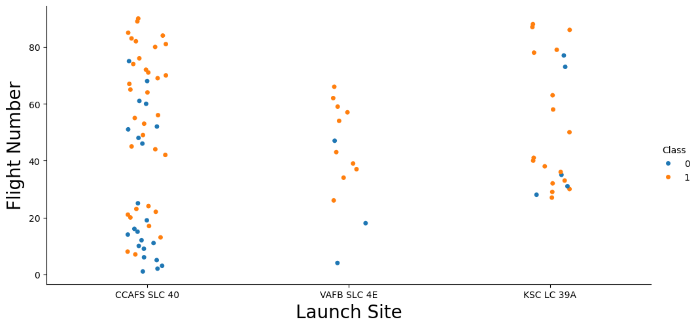
Flight Number vs. Launch Site
Flight Number vs Launch Site (Cat Plot)
Rate of success has grown over time at each site, though KSC LC-39A seems to be the most consistent

Slide 25
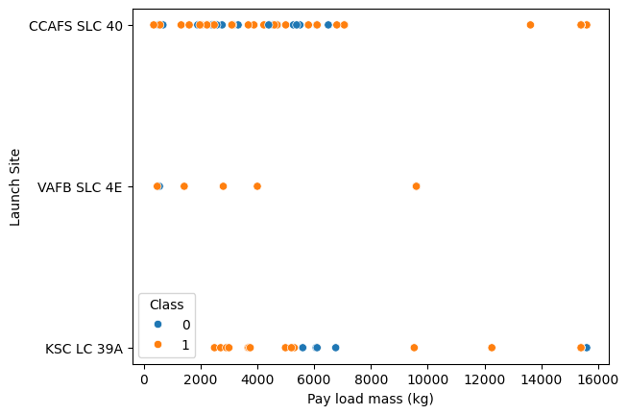
Payload vs. Launch Site
Smaller payloads (<6000 kgs) seem to correlate with higher success rate

Slide 26
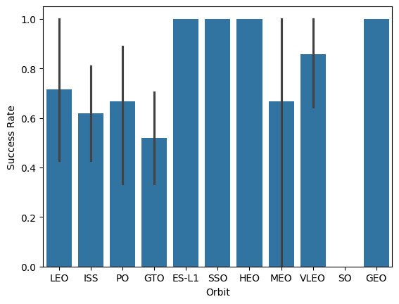
Success Rate vs. Orbit Type
ES-L1, SSO, HEO, and GEO orbits are very reliable

Slide 27
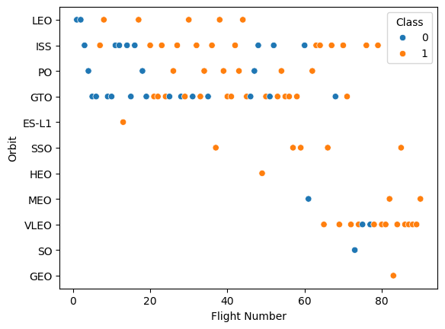
Flight Number vs. Orbit Type
• However, ES-L1, HEO, and GEO success rate may be skewed due to each having only 1 launch
• LEO, SSO, and VLEO seem all have high success rates while having high sample sizes

Slide 28
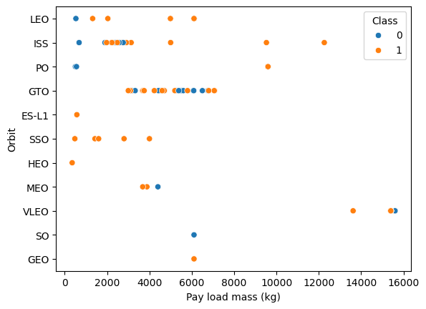
Payload vs. Orbit Type
• LEO and SSO orbits’ success may be due to light payloads

Slide 29
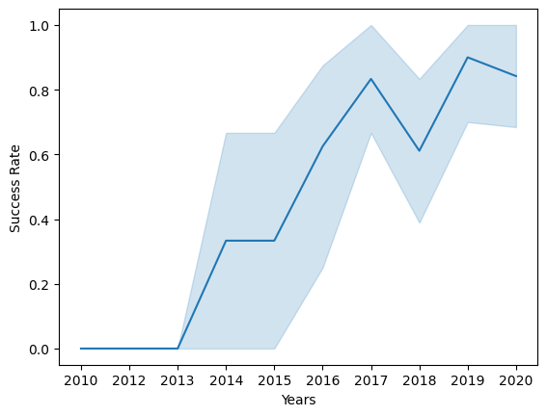
Launch Success Yearly Trend
Overall success rate increased from 2013 to 2017, where it has more or less stagnated

Slide 30
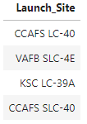
All Launch Site Names
According to the SQL Query on the right, we have 4 unique launch site locations:

Slide 31
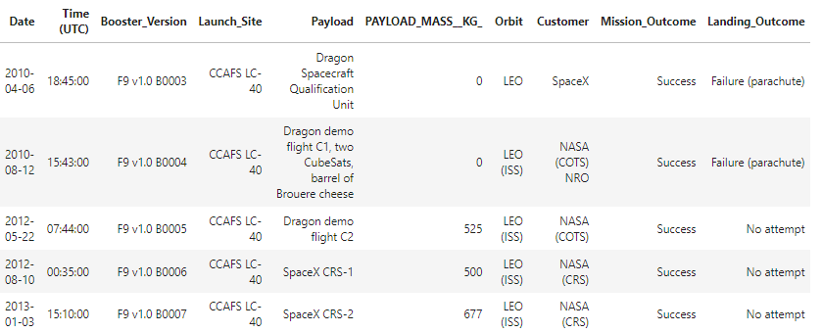
Launch Site Names Begin with 'CCA'
These are the first 5 records for launch sites that begin with ‘CCA’:

Slide 32
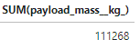
Total Payload Mass
Here is the total payload mass (in kg) carried by boosters from NASA:

Slide 33
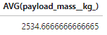
Average Payload Mass by F9 v1.1
On average, rockets with by booster version F9 v1.1 carry a mass of:

Slide 34
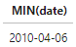
First Successful Ground Landing Date
The first successful Stage One recovery landing occurred on:

Slide 35
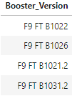
Successful Drone Ship Landing with Payload between 4000 and 6000
List the names of boosters which have successfully landed on drone ship and had payload mass greater than 4000 but less than 6000

Slide 36
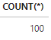
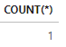
Total Number of Successful and Failure Mission Outcomes
In total, there were 101 missions recorded in this database
These 101 missions were either a:
Success
Failure

Slide 37
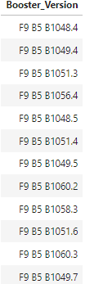
Boosters Carried Maximum Payload
Here is a list of the names of boosters which have carried the maximum payload mass:

Slide 38
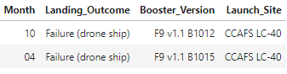
2015 Launch Records
In 2015, there were two launches which resulted in a failed Stage One recovery:

Slide 39
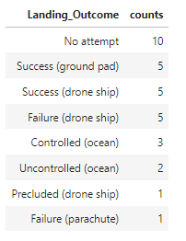
Rank Landing Outcomes Between 2010-06-04 and 2017-03-20
This is a rank of the types and number of landing outcomes (in descending order) between dates 2010-06-04 and 2017-03-20:

Slide 40

Section 3

Slide 41
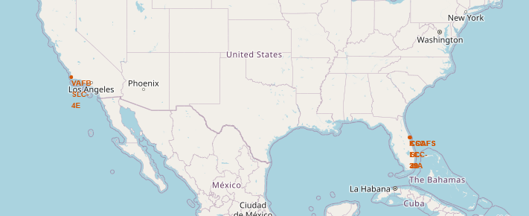
Map of Launch Site Locations
As can be seen, SpaceX has one launch site on the Pacific coast of Southern California
The rest of the launch sites are located on the Atlantic coast of Florida

Slide 42
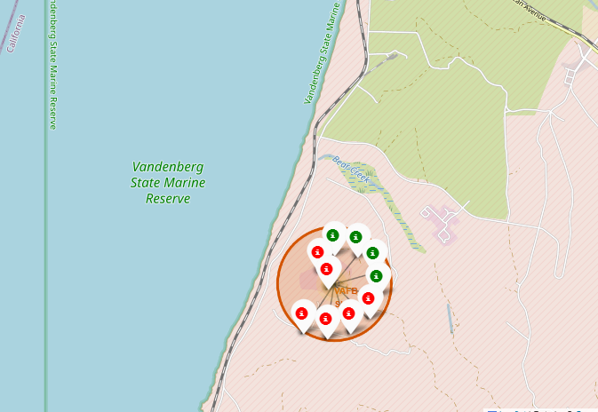
VAFB SLC-4E Recovery Outcomes
Each marker represents a Falcon 9 Stage One recovery
Green - successful recovery
Red - unsuccessful recovery

Slide 43
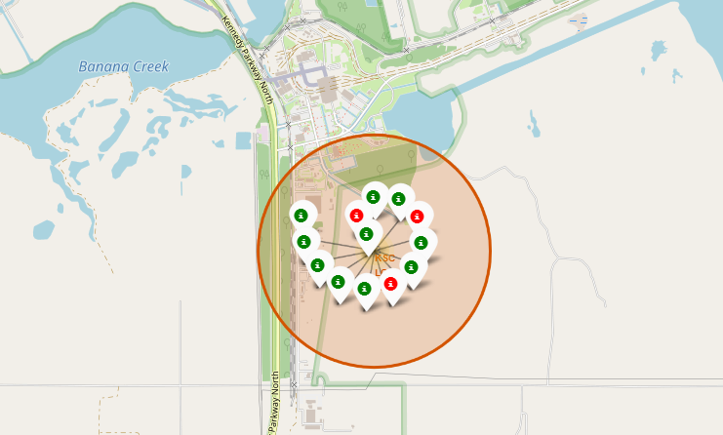
KSC LC-39A Recovery Outcomes

Slide 44
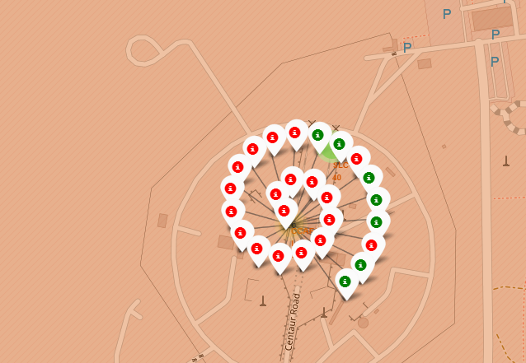
CCAFS LC-40 Recovery Outcomes

Slide 45
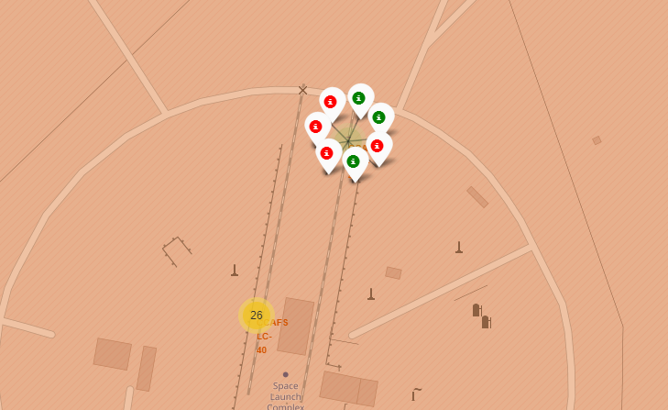
CCAFS SLC-40 Recovery Outcomes

Slide 46
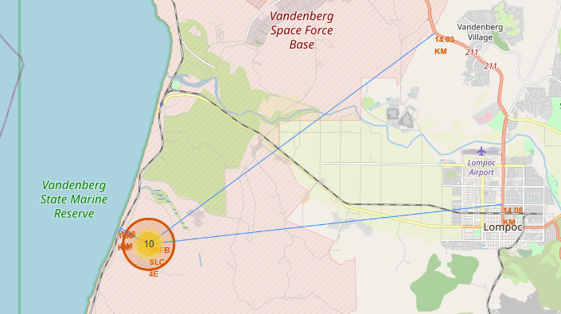
VAFB SLC-4E Nearby Locations
Each blue line represents the distance to the nearest
coastline
city/town
railway
highway
Notes:
Reasonable distance from closest city and highway (both ~14km)
Very close to coast and nearest railway (both <2km)

Slide 47
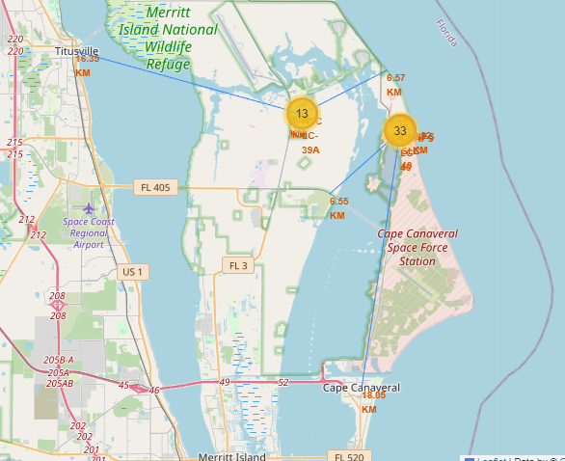
KSC LC-39A, CCAFS LC-40, and CCAFS SLC-40 Nearby Locations
Reasonable distance to nearest towns (>15km)
Launch sites located very close to coast and surprisingly close to railways and highways (<7km)

Slide 48

Section 4

Slide 49
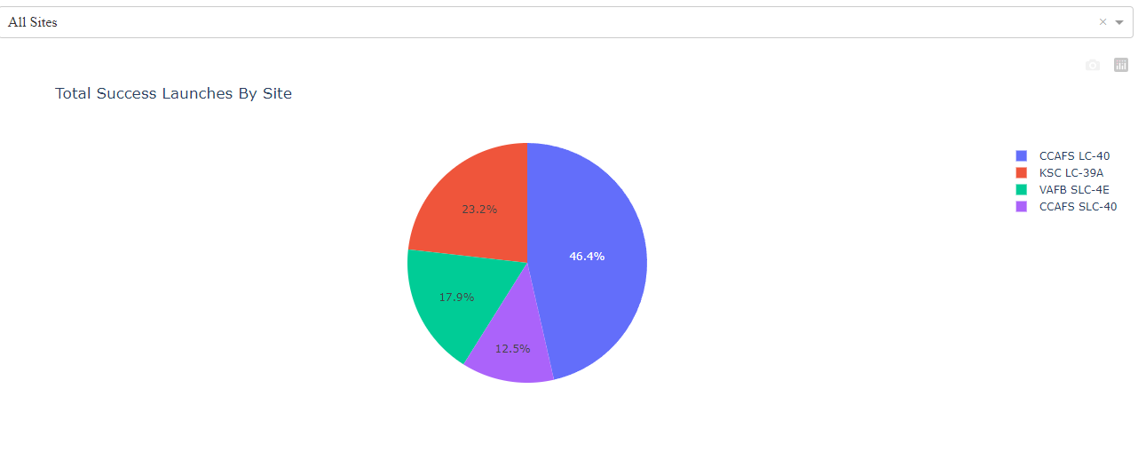
Pie Chart of Successful Launches by Site
Here is a breakdown of the total amount of successful launches by site:
• CCAFS LC-40 is the location of over half of SpaceX’s successful launches

Slide 50
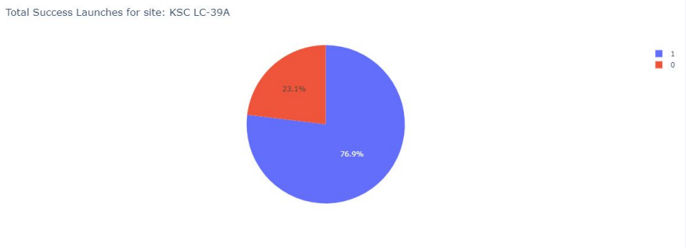
Most Proportionally Successful Launch Site
CCAFS LC-40 has the most launches, so naturally it has the most successful launches
KSC LC-39A, comparatively, has fewer launches overall but the proportion of success is higher

Slide 51
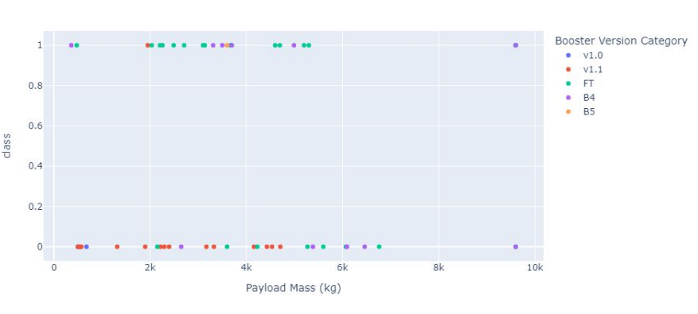
Recovery Outcome vs. Payload Mass Scatter Plot
The most successful payload range appears to be from 2000-4000kg
The v1.1 booster seems to have failed the most while the FT booster appears to be very successful

Slide 52

Section 5

Slide 53
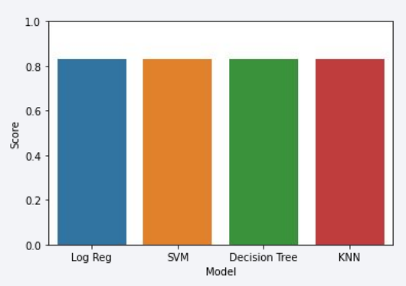
Classification Accuracy
Here is a barplot for the accuracy score of each model. As can be seen, when testing them on our test data, they all exhibit identical scores (83.33%)
Practically, all of these methods perform equally well with a score of 83.33%. The one exception is decision tree classification, which has a score of 77.78%.

Slide 54
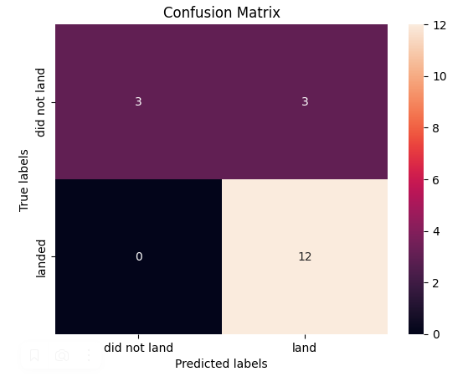
Confusion Matrix
Our KNN model was mostly accurate, however it wrongly predicted three landings as being successful where they were not

Slide 55
Conclusions
SpaceX’s successful recoveries generally have the following properties:
A launch date in the year 2017 or later
Light payload (in the range 2000-4000kg)
Launched from site KSC LC-39A
Successfully recovered via drone ship
Our model can predict the outcome of a given recovery with a reasonable degree of accuracy, 83.33%

Slide 56


